Slide 1
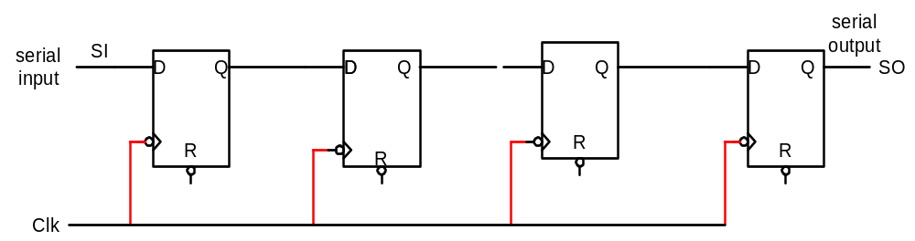
4-bit Shift Register
1
0
1
0
0
0
0
0
0
0
0
0
1
1
0
0
0
0

